Slide 1
Design Fresh Messaging:
How to get the best thinking out of your development team
Lieve Hendren, CFRE | Senior Consultant & Director of Strategic Initiatives at Alford Group
Mariah (Fosnight) Hickey, CFRE, MBA, MID | Senior Consultant & Director of Client Service at Alford Group

Slide 2
Today’s Agenda
Who’s in the room? (5 min)
SOAR Analysis Framework & strength-based messaging (10 min)
Samples (5 min)
Individual SOAR exercise (15 min)
Breakout groups (20 min)
Share out (15 min)
What you can do now? (5 min)

Slide 3
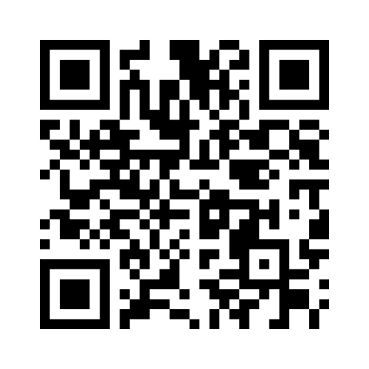
Who’s in the room?
Scan the QR code
OR
Go to www.menti.com
Enter code 8528 7746

Slide 4
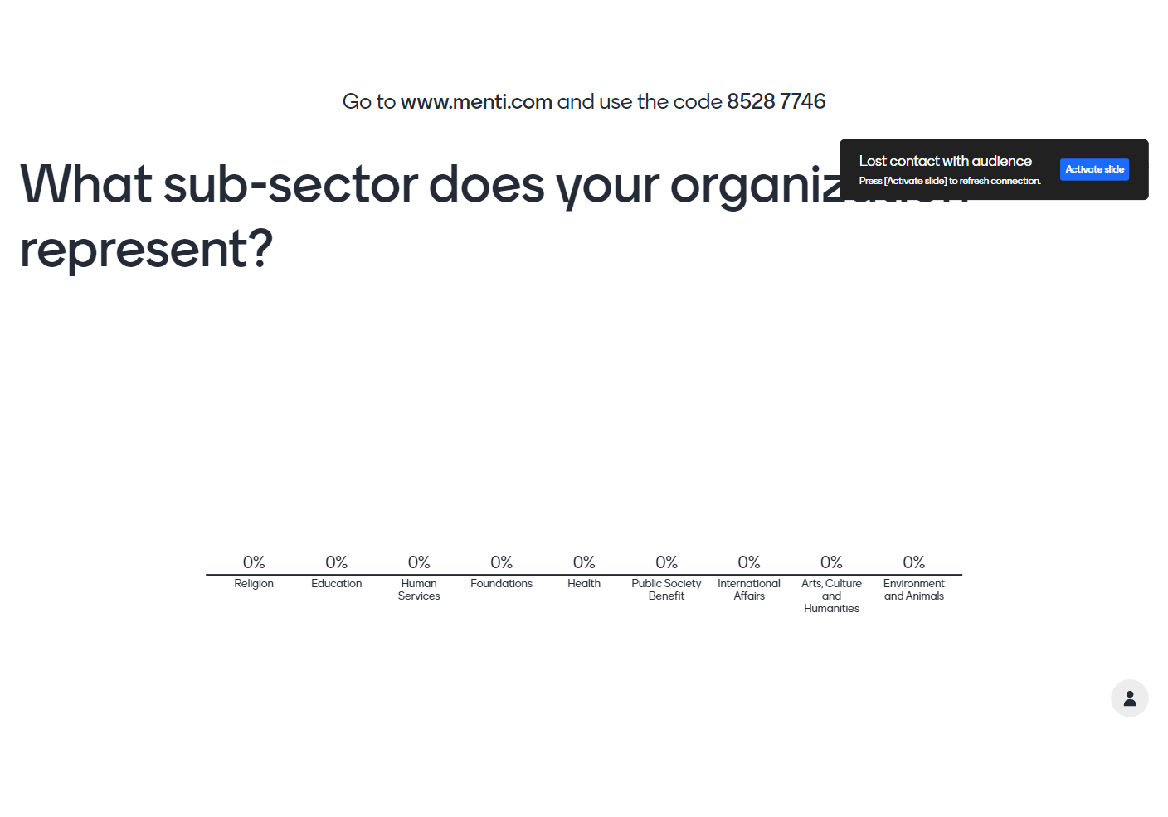

Slide 5
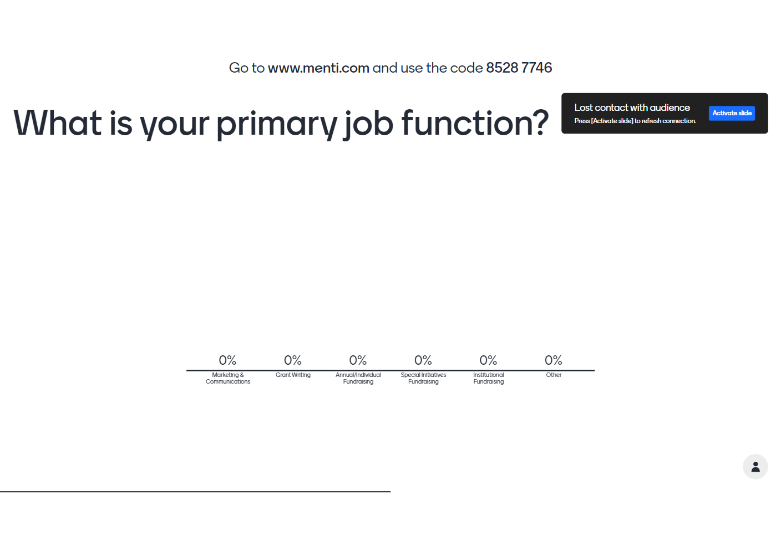

Slide 6
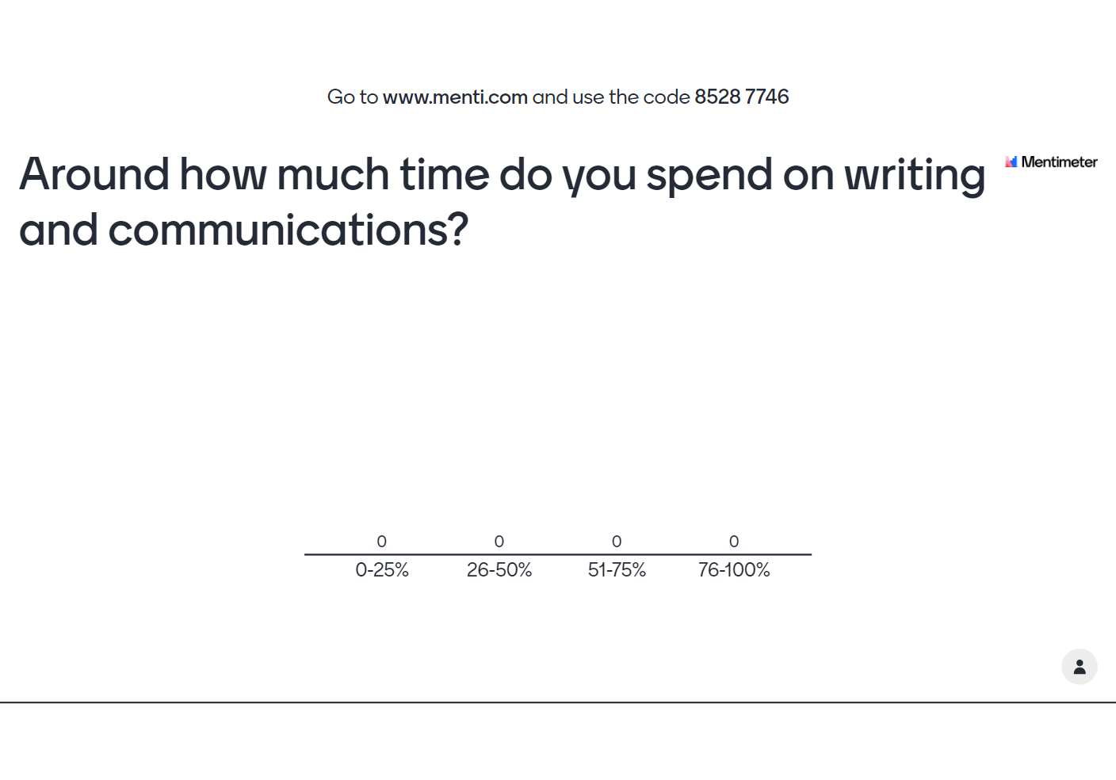

Slide 7
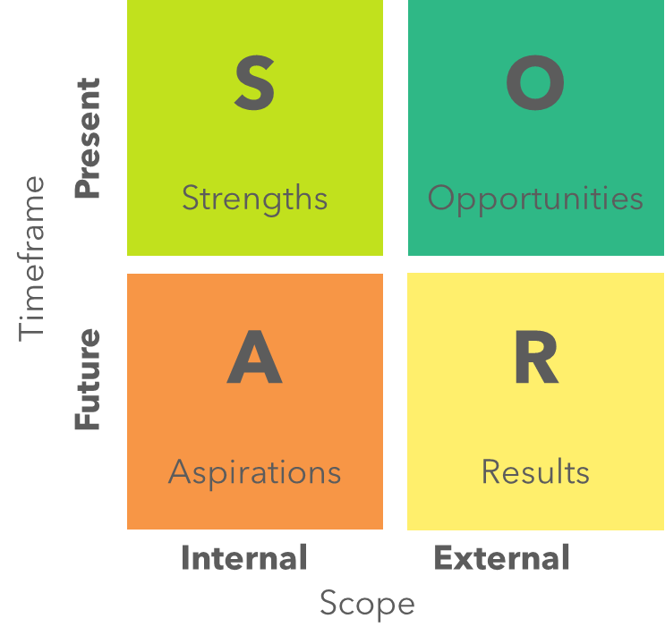
SOAR Analysis Framework
Unlike other frameworks, SOAR marries fact-finding about the organization with the desires of the stakeholders

Slide 8

What is strength-based messaging?
Invites readers into a vision toward a brighter future
Reframes challenges as opportunities
Shares an understanding of success
Builds on strengths/positive and uplifting, counteracting the negativity bias
Builds bridges by focusing on alignment, rather than differences
Positive Psychology (Martin Seligman)

Slide 9

Applying Strength-Based Messaging
Engage the people you work and center voices that often get marginalized (how do THEY want to be represented in communications)?
Focuses on self-direction and the possibility for change when needs are met
Frames challenges as opportunities to get involved in making a difference
Prosper Strategies; Donald Miller BrandStory

Slide 10
Applying Strength-Based Messaging
Equity-centric, empowering and respectful
Watch-out for stereotypes or ‘needs-based’ messaging
Avoid ‘heroes’ or saviorism language
Inclusive and aspirational
Prosper Strategies; Donald Miller BrandStory

Slide 11
Sample: Terminology & People-First Guide
Use: | Instead of:
Older adults | Seniors or elderly
Neighbors, people or community members | Clients
People/children living in low-income households or people with low incomes | Low-income or poor adults/children
People-first language upholds human dignity

Slide 12
Your Turn: SOAR Exercise
Individually (15 min):
  Use your workbook to brainstorm S-O-A-R for your organization
  Identify the top 3 key messages or messaging ideas
In groups of 4-5 (20 min):
  Share your top 3 key messages or messaging ideas
  Listen and offer feedback and/or insights

Slide 13

Share Out
What exciting messaging did you hear?
Where did you get stuck?
What are your immediate next steps / how will you apply what you’ve brainstormed today?

Slide 14

What can I do now?
Create a “say this, not that” guide
Conduct a communications audit
Review your style guide
Develop a community engagement plan
Hire counsel to conduct a SOAR analysis
Research language trends in your sector
Learn more with free resources, like Prosper Strategies

Slide 15
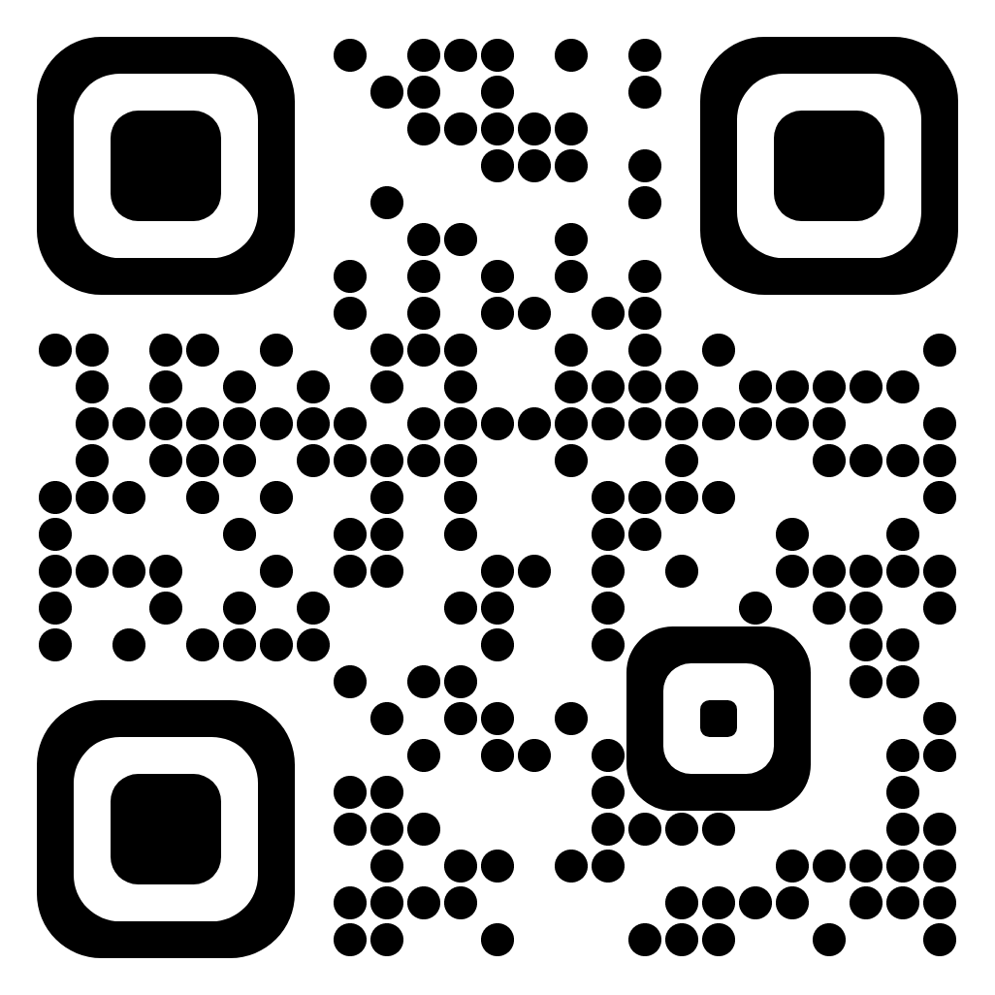
Let’s stay in touch!
Lieve Hendren, CFRE | Senior Consultant & Director of Strategic Initiatives at Alford Group | lhendren@alford.com
Mariah (Fosnight) Hickey, CFRE, MBA, MID | Senior Consultant & Director of Client Service at Alford Group | mhickey@alford.com

